Slide 1



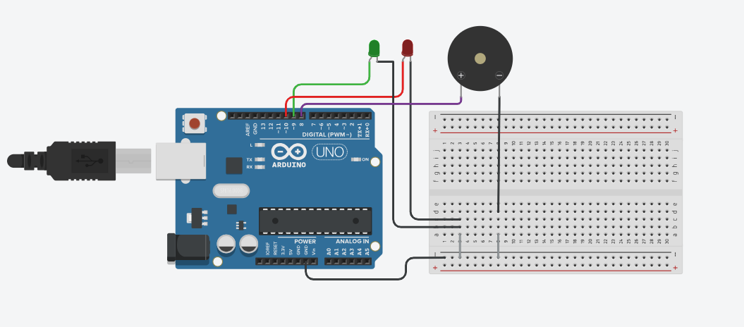
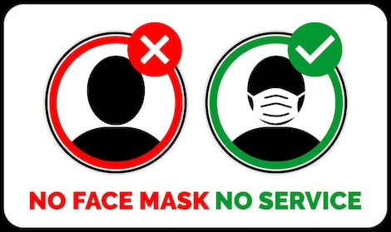
Abstract
Face Mask Detection
The FMD system uses a webcam to detect masks in real-time. When a mask is detected, a green light and sound signal compliance. If no mask is detected, a red light and warning sound alert. Built with Python and Arduino, this system promotes mask-wearing.
Conclusions
Materials
The system demonstrated reliable performance in accurately detecting whether individuals were wearing masks or not.
The integration of hardware components such as LEDs and a buzzer provided immediate and intuitive feedback, enhancing user awareness.
User feedback indicated a positive response to the system's functionality and effectiveness in encouraging mask compliance.
Hardware Components
Laptop/Desktop Computer with Webcam.
Arduino Uno.
Red LED, Green LED, Buzzer.
Software Components
Python Program.
Arduino Code.
Serial Communication.
Question
Can we make a system that quickly checks if someone is wearing a mask using a camera and smart technology?
Hypothesis
By using special computer programs and sensors, we can create a system that accurately tells if someone has a mask on or not. This system can help remind people to wear masks in public places.
Procedure
Future Directions
First, connecting the Arduino to the computer and making sure that the webcam is working. Then, install Python and special tools for recognizing masks and faces. Write a program in Python that uses the webcam and tools, tell the Arduino what to do when it detects masks. Testing the system with different lights and masks to check if it works properly.
In the future, there are some interesting plans to improve the capabilities of the system. Through the addition of sophisticated features, like the ability to identify different kinds of masks and maximize speed and efficiency, the goal is to make it more intelligent. The primary objective is to continuously improve the system's performance and usability to contribute positively to public health and safety measures.
Background Research
Other studies have already investigated how we can use computers to see if someone is wearing a mask. Some have used special computer brains called neural networks, while others have focused on using webcams for real-time detection. Learning from these studies helps us make our mask detection system better.
Results
The system detected whether people were wearing masks or not with rapidity and precision. It was simple to understand because of the sound and lighting. Enhancing the system further is the next stage.

